Slide 1
Self-Esteem & Peer Pressure
Click on the speaker icon below for an introduction to this segment

Slide 2
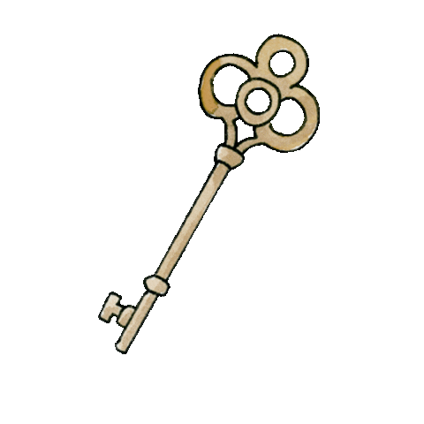
When Building your Child’s self-esteem
Social-Emotional Development is Key
Here is a brief video to help build self-esteem

Slide 3
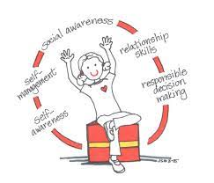
What does social-emotional development look like now?

Slide 4
5 Competencies – Let’s’ go Define them
Self-awareness
______________________________________________________________________________
Self-management
______________________________________________________________________________
Social awareness
______________________________________________________________________________
Relationship skills
______________________________________________________________________________
Making responsible decisions
______________________________________________________________________________

Slide 5
Choices Based on: SELF

Slide 6
Choices Based on: OTHERS

Slide 7
Choices Based on: SELF & OTHERS

Slide 8
2nd Grade
Enjoy being part of a team, group, or club
Experience periods of dramatic emotion and impatience (feeling that everyone is against them) and then bounce right back to everything being just fine
Start seeing things from other points of view and incorporate that into everyday life
Be somewhat aware of others’ perceptions of them
Want to behave well, but aren’t yet very attentive to directions

Slide 9
3rd Grade
Have moments of extreme insecurity and need a lot of encouragement from family and loved ones
Change often between being helpful and upbeat to being unhelpful and grouchy
Share secrets and jokes with friends
May start to develop own identity by withdrawing from family activities and conversations
Are affectionate, silly, and curious, but can also be selfish, rude, and argumentative

Slide 10
4th Grade
A key developmental accomplishment at this age is having a best friend in whom your child starts to trust.
This is also the age when children first experience the emotion of loneliness based on missing a close friend.
At this age children learn that behavior has an impact on those around them, and they may need to modify their actions related to their environment.
Children begin to demonstrate the ability to resolve conflict with peers by talking through the problem. They are able to see both perspectives of the disagreement and often resolve the problem and remain friends.
At this age children tend to pick friends of the same gender.

Slide 11
5th Grade
At this age friendships are more important than school work.
They will spend more time socializing with friends, texting, video chatting, etc.
Children become more attuned to what peers are wearing, the music they are listening to, etc.
At this age they are able to adjust behaviors to resolve conflicts and help others resolve conflicts in a positive manner.
Children are able to cooperate with peers even in competitive situations and understand the effort is usually more rewarding than the outcome.

Slide 12
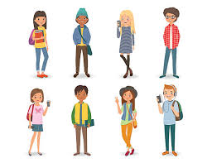
Looking ahead….
Start thinking more logically
Are introspective and moody and need privacy
Value friends’ and others’ opinions more and more
May test out new ideas, clothing styles, and mannerisms while figuring out where/how to fit in

Slide 13
What skills are we Teaching/Modeling?
Communication
Getting Along with Others
Assertiveness - expressing your point of view in a way that is clear and direct, while still respecting others. Communicating in an assertive manner can help you to minimize conflict.
Check thIs Out
Problem-Solving ( Respond vs React)
Segment on how to handle a bully ( show kids starting at 4:22)

Slide 14
Benefits to what we are teaching/ModelinG
Self- Awareness
Confidence
Empathy for Others
Relationship Skill Building
Cope Better with Emotional Stress
Resilience

Slide 15
Remember there is POSTIVE Peer Pressure

Slide 16
Causes of Peer PrESSURE – Why some feel it more than others
The Need to Fit In
Low Self-Esteem
Fear of Rejection
Need to Feel Safety and Security from Peers
*MOST COMMON AGE Peer Pressure is Felt: 12-19 yrs old

Slide 17
Guiding our Children on How to Handle PEER PRESSURE
Prepare for Possible Situations
Set Family Rules – morals, values, beliefs
Discuss Effective Responses
Choose the Right Friends – have them over, meet their parents
Stop and Think First
Talk about the Dangerous Behavior – Be Honest with them about your choices

Slide 18
Emotional Regulation (do it) through Emotional empowerment ( own it)
Discuss emotions
Help children label and identify emotions
Help children learn strategies they can use when dealing with certain emotions

Slide 19
Helping your child cope with adversities through: Seven C's of Resilience
Competence- the ability to handle situations effectively
Confidence- the solid belief in one's own abilities
Connections- close ties to family, friends, school, and community give children a sense of security and values that prevent them from seeking destructive alternatives to love and attention.
Character- a fundamental sense of right and wrong that helps children make wise choices, contribute to the world, and become stable adults.
Contribution- when children realize that the world is a better place because they are in it, they will take actions and make choices that improve the world. They will also develop a sense of purpose to carry them through future challenges.
Coping- children who learn to cope effectively with stress are better prepared to overcome life's challenges.
Control- when children realize that they can control their decisions and actions, they're more likely to know that they have what it takes to bounce back.

Slide 20
Keys to handle Peer Pressure
Pay Attention to How You Feel
Plan Ahead – Learn how to spot ( direct, indirect, negative, positive)
Talk to the Person who is Pressuring you….tell them How you Feel and tell them to Stop
Have a Secret Code to communicate with parents
Give an Excuse
Have Friends with Similar Values and Beliefs
*Video by Brooks Gibbs – this video is called How to Stop a Bully. This is not exclusive to bullies. It gives great background information for adults but starting at the 4:22 minute mark is a great example to show your pre-teens. This is a challenging default strategy to master so teach it young.

Slide 21
What you can do
Don’t OVERREACT - Be open, Judgement Free
Applaud Good Choices
Talk about What Makes a True Friend
Get to Know Your Child’s Friends
Talk About what Independence is and how it is Earned
Role Play ( Plan ahead or revisit)
Make Sure your home is a Harbor in the Storm
TEACH THEM: You are the MASTER of YOUR OWN CHOICES, But you are NOT FREE from the CONSEQUENCES that Follow

Slide 22
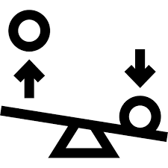
Remember
We DEFAULT to how we were raised. That is not to say it was good or bad, the right way or the wrong way, there are just other options if something is not working.
Trying something requires time and effort, doing something one time is not sufficient to determine if it is working or not
SELF-ESTEEM
PEER-PRESSURE

Slide 23
Great Resources
Parentingmontana.org
Loveandlogic.com
How to Stop a Bully Video Link
Blog
Weekly Newsletter

